Slide 1
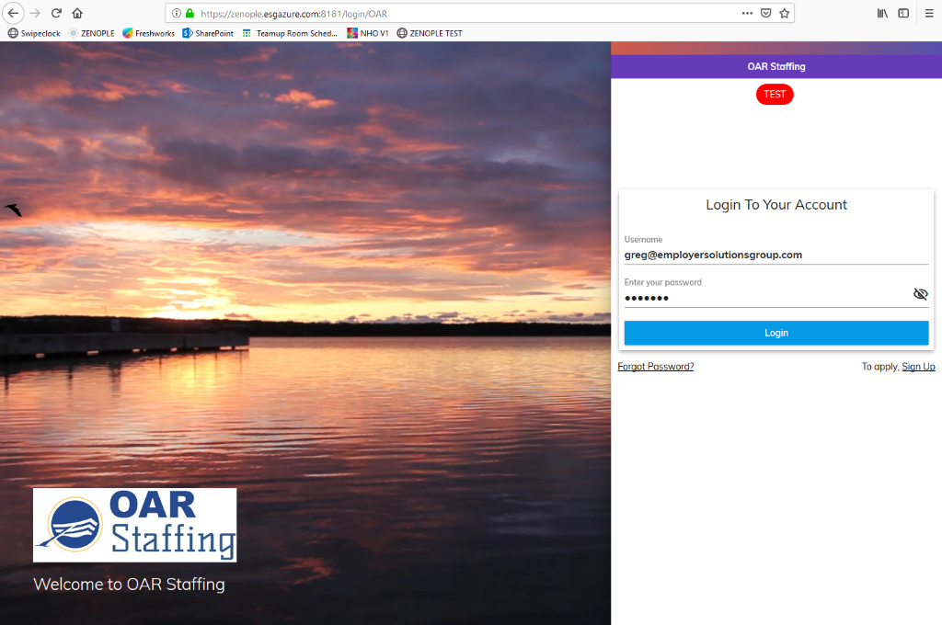
https://zenople.esgazure.com/login/ABC
1.
2.
3.
Go to your unique login link
Enter your login credentials
Login

Slide 2
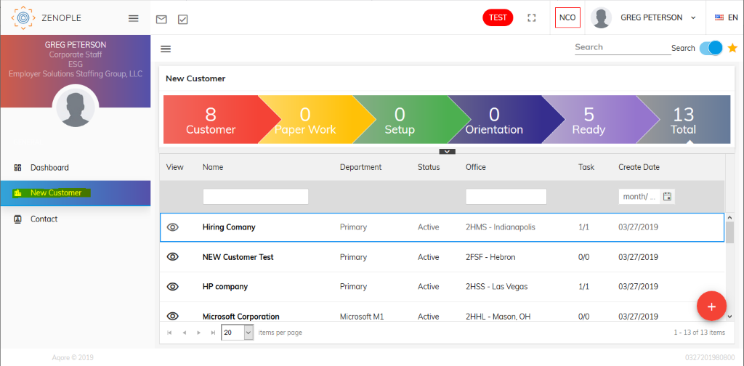
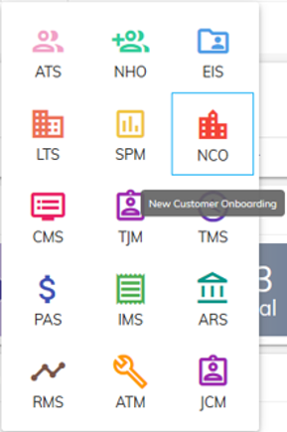
1.
2.
3.
4.
Open the application navigation
Select New Customer Onboarding (NCO)
Select New Customer from left hand menu
Click the red add button

Slide 3
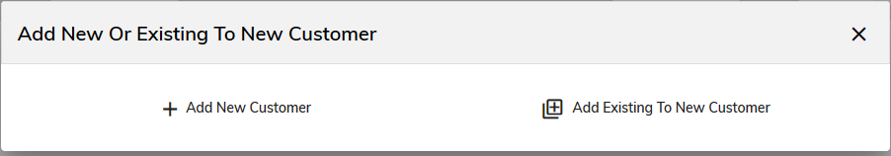
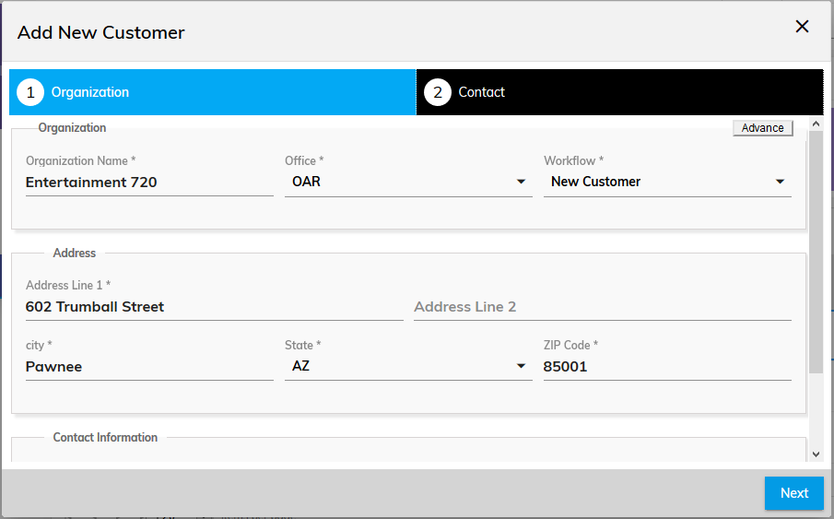
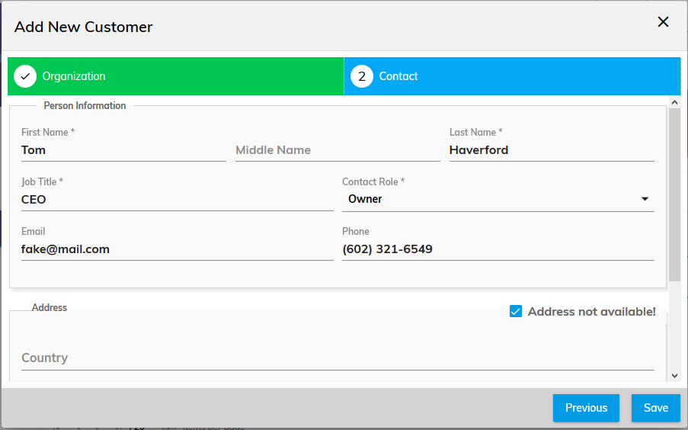
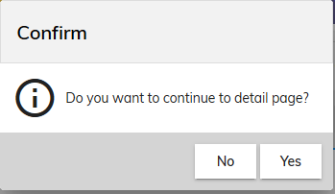
1.
2.
4.
6.
3.
5.
Click the add new customer option
Enter organization information
Click next
Enter main contact’s information
Click Save
When asked via pop up if you want to continue to the detail page select yes

Slide 4
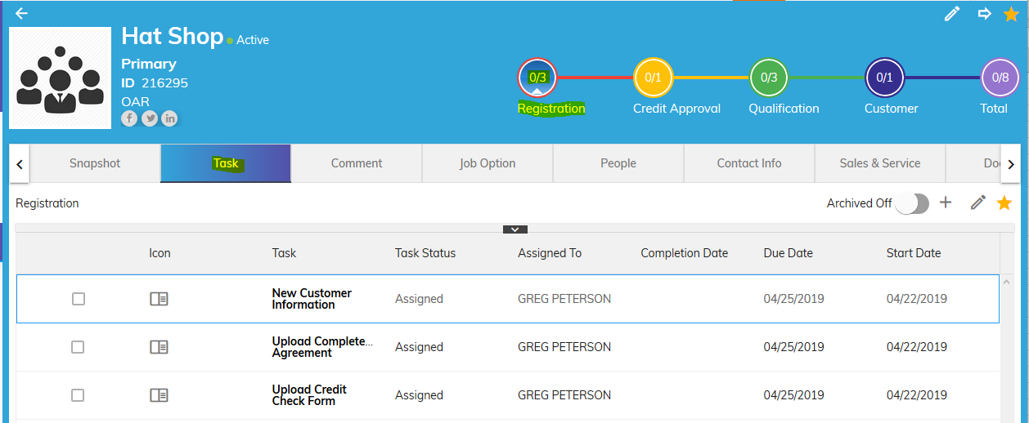
1.
2.
3.
4.
1. Click on the Registration Stage – This will bring you to the Task Tab
2. Click New Customer Information and complete the missing info.
3. Click Upload Complete... Agreement to import the signed staffing agreement
4. Click Upload Credit Check Form to import the signed credit check form if applicable

Slide 5
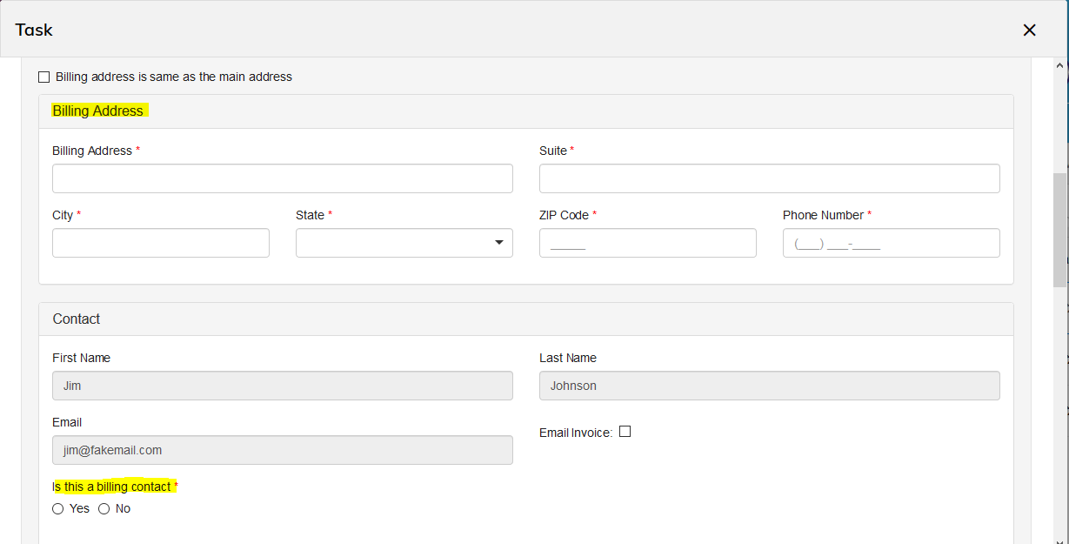
2.
If Billing Address is the same as main address check the box above or enter a new Billing Address

Slide 6
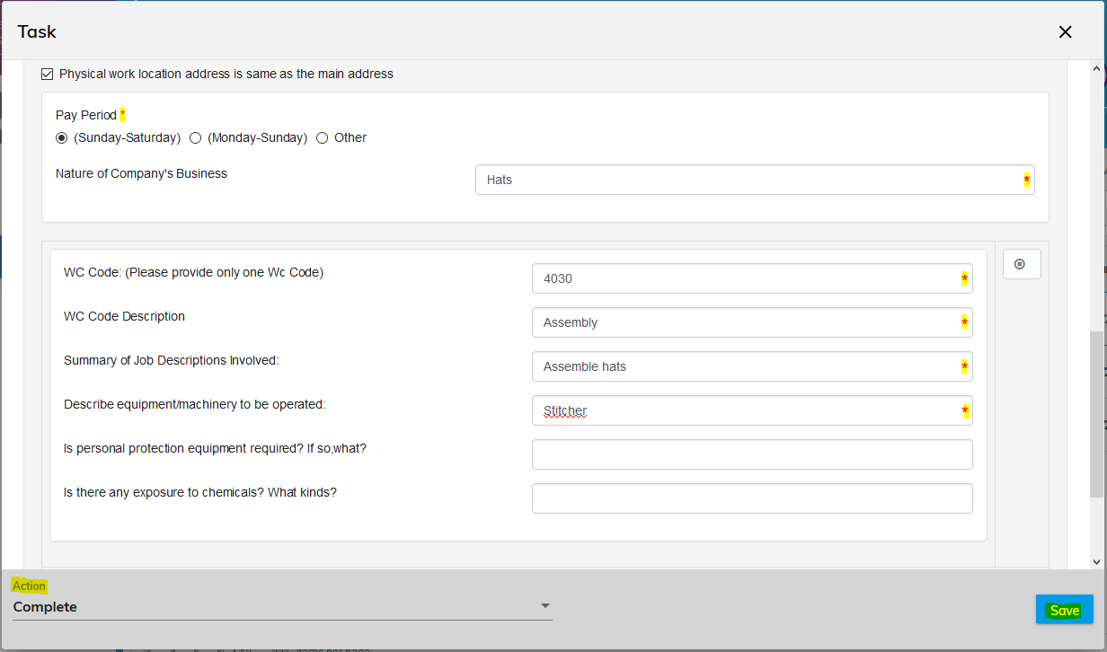
2.
Select the Pay Period and enter the Nature of Company's Business
Enter WC Code, WC Code Description, Summary of Job Descriptions and Equipment/Machinery
Select Complete from the Action Menu and click Save – This task will now be complete

Slide 7
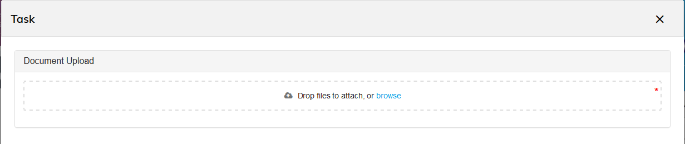
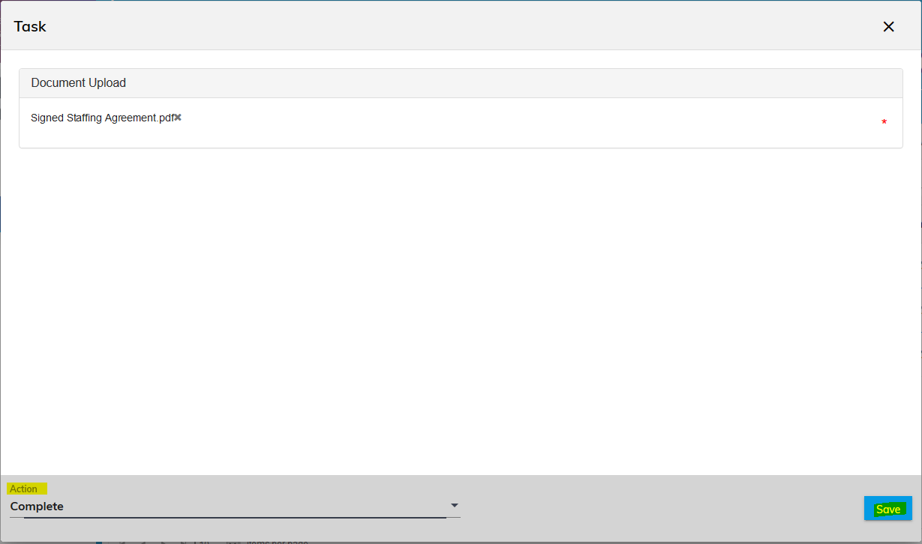
3. Click Upload Complete... Agreement to import the signed staffing agreement
Click browse, select file, click Complete in the Action Menu and click Save.

Slide 8
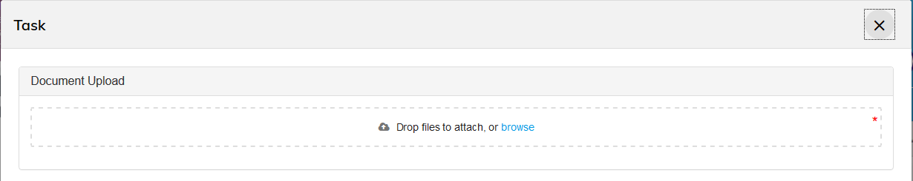
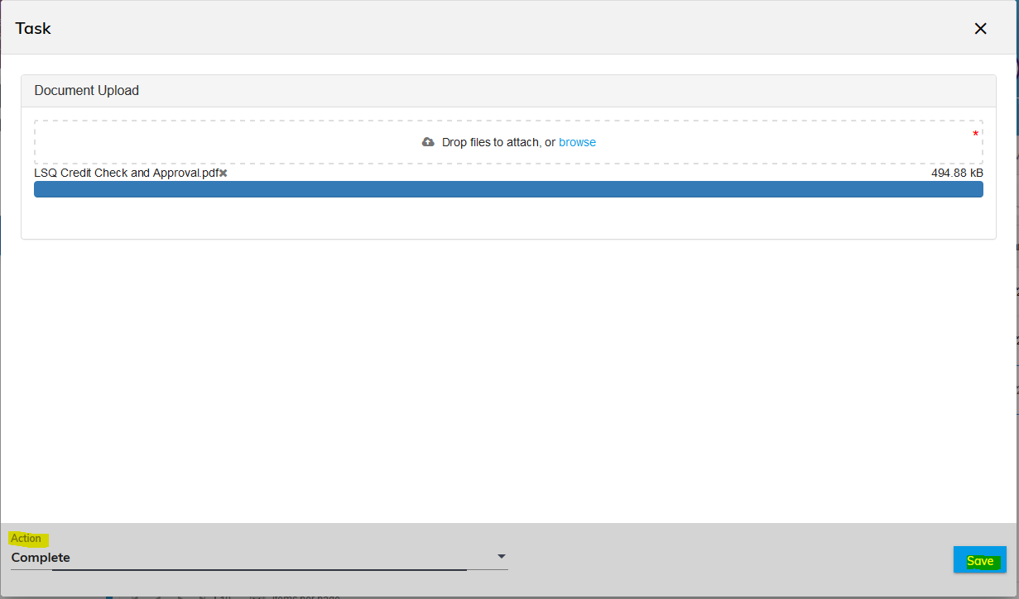
4. Click on Upload Credit Check Form to import Credit Check Form
Click browse, select file, click Complete in the Action Menu and click Save.

Slide 9
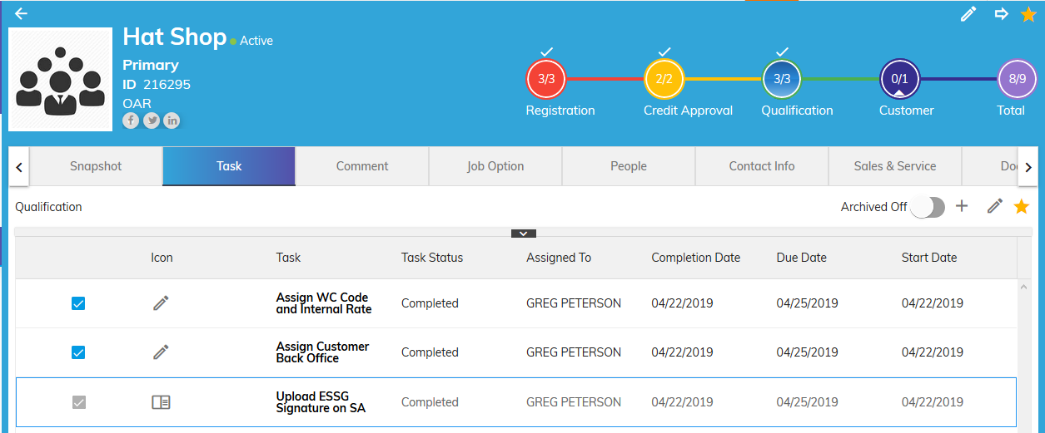
Once the Registration Tasks have been completed, ESG will complete the Credit Approval (if applicable) and the Qualification stage to assign WC Codes and Rates

Slide 10
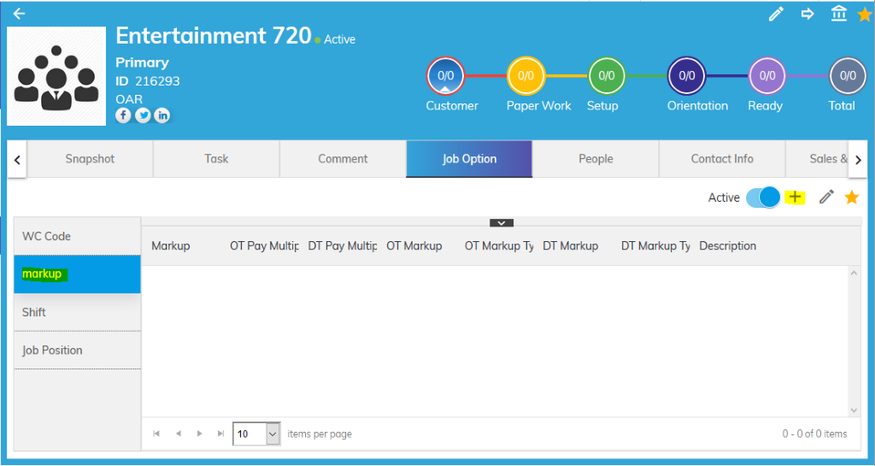
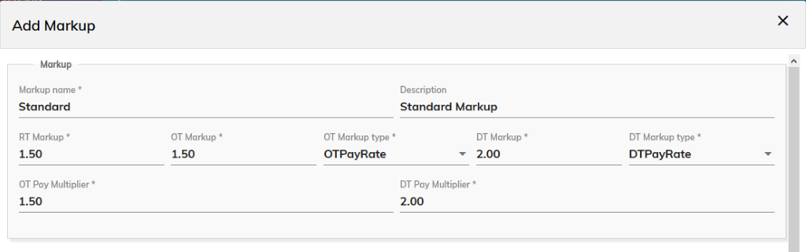
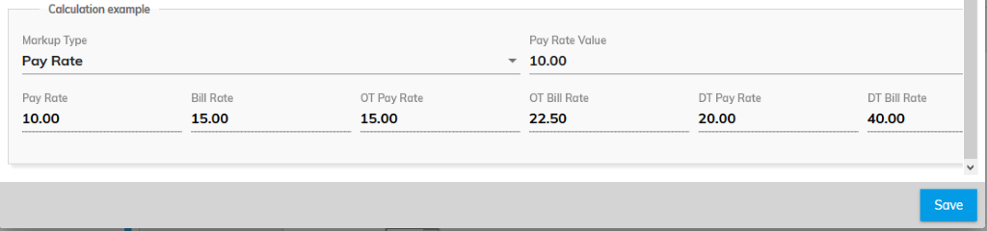
To add a markup open the Job Option tab
Select markup from the left hand menu
Click the add button
Enter the markup information
Click the save button
1.
3.
4.
2.
5.

Slide 11
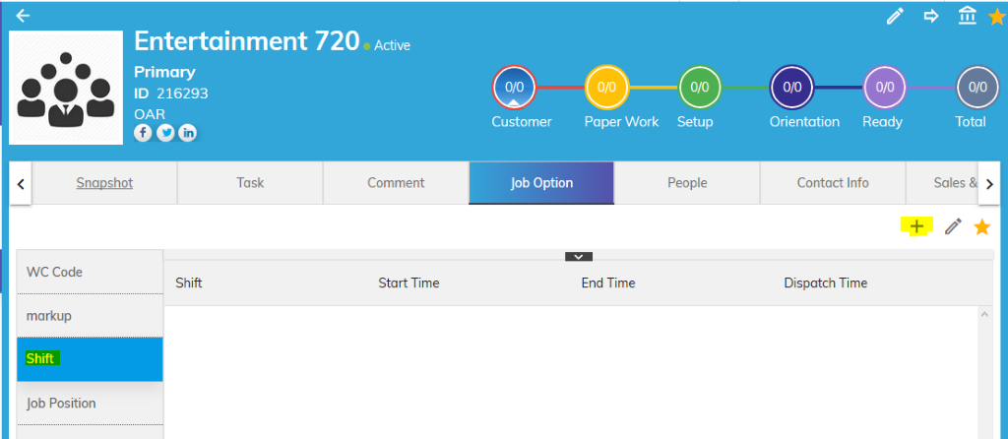
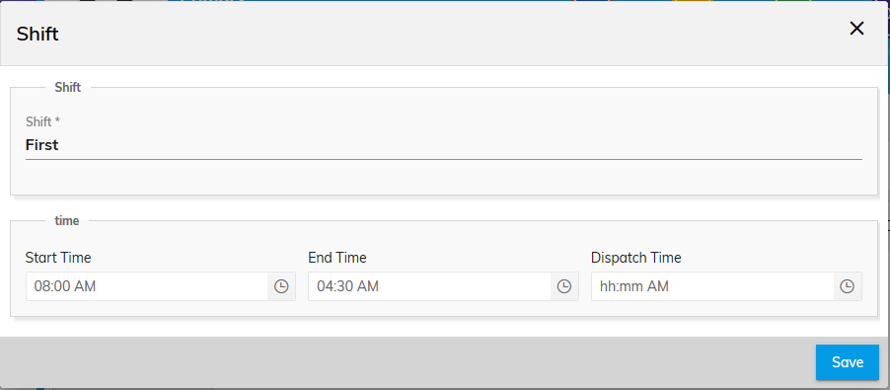
1.
3.
4.
2.
5.
To add a shift open the Job Option tab
Select shift from the left hand menu
Click the add button
Enter the shift information
Click the save button

Slide 12
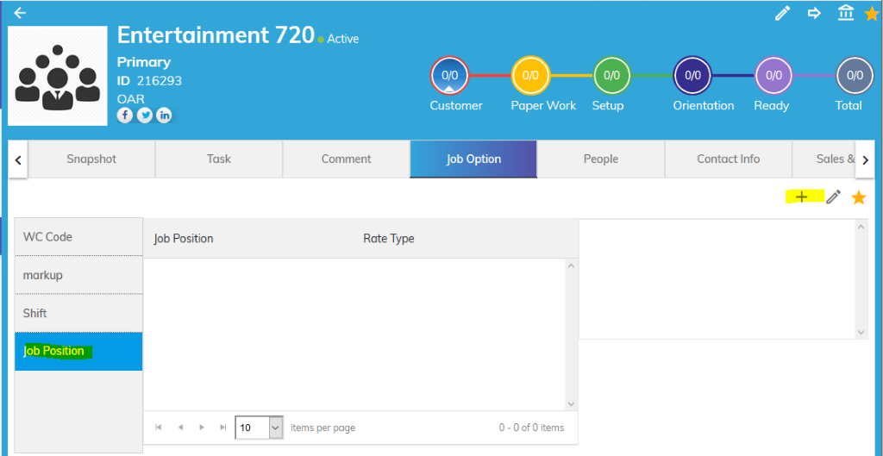
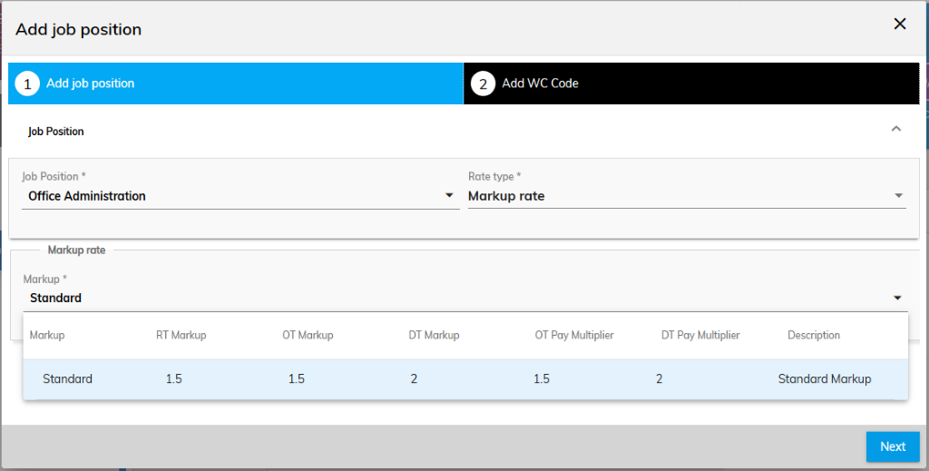
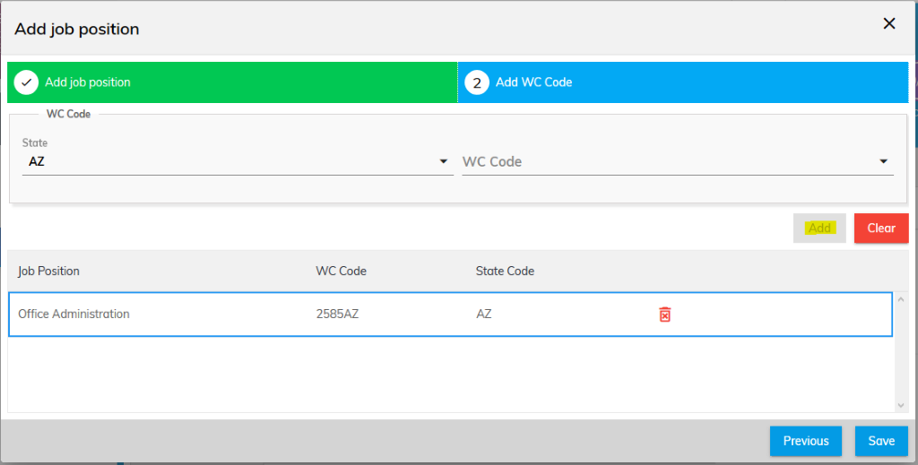
To add a job position open the Job Option tab
Select job position from the left hand menu
Click the add button
Select the job position
Select the rate type
Select the markup rate (if applicable)
Click next
Select state
Select applicable WC code
Click add
Click the save button
1.
3.
4.
5.
6.
2.
7.
8.
9.
10.
11.

Slide 13
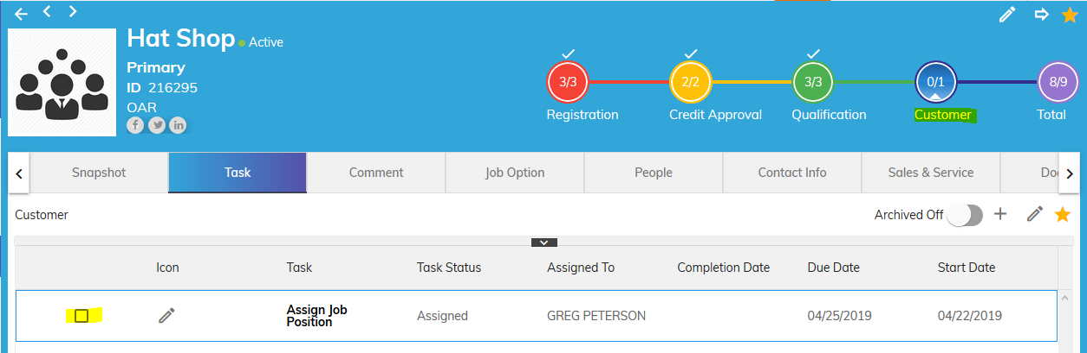
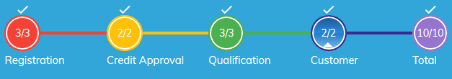
After the Job Position(s) have been created, navigate to the Customer Stage. Here you can click the Task checkbox to move this customer to the CMS.

Slide 14
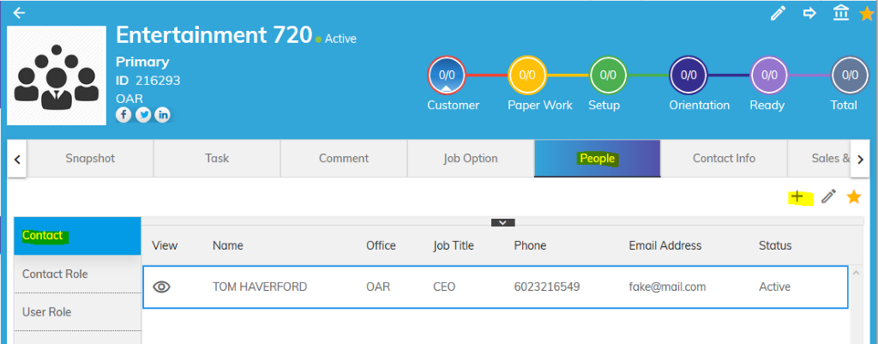
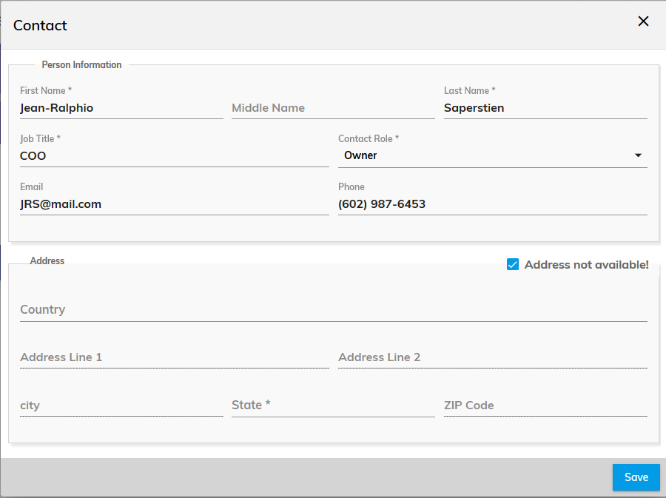
1.
4.
3.
2.
To add additional contacts open the people tab
Select contact from the left hand menu
Click add
Enter contact’s information
Click the save button
5.

Slide 15



Icon List
Selected App
Task Icon – Can be edited in Task Tab
Quick View - Eye Icon to quickly access customers
Task Icon – Needs to be edited or completed in another Tab
Pin/Unpin left hand menu
More available options
Enter Fullscreen Mode
Exit Fullscreen Mode
Add Button or Fab Button
To Do Tasks
Edit
Pin Shortcuts
Add
Edit
Refresh
Email/Mailbox

