Slide 1
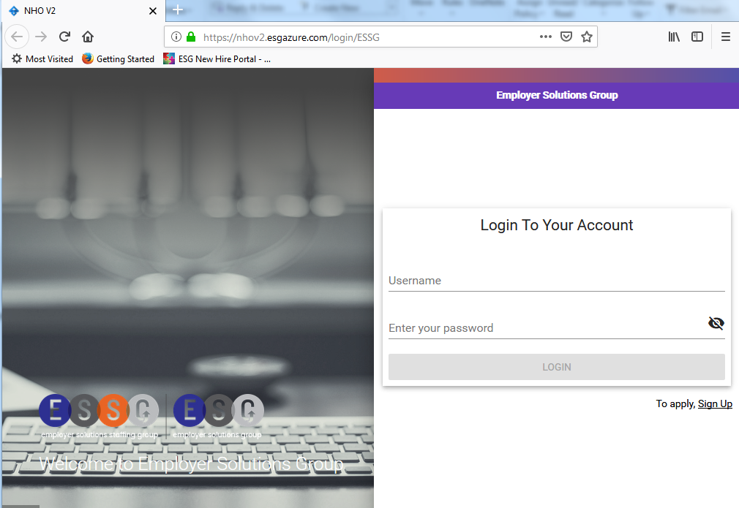
Use the custom link provided by your recruiter to reach your portal landing page
Click the “to apply, Sign Up” link in the bottom right hand corner
xxx
1.
https://nhov2.esgazure.com/login/XXX
2.

Slide 2

1.
Answer the two prescreening questions

Slide 3

1.
Search for your recruiter’s nearest office by zip code or state. Select the correct office from the search results.

Slide 4
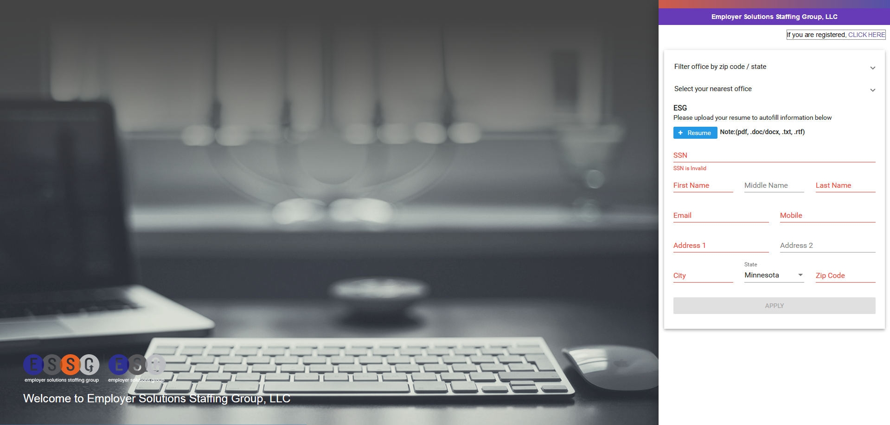
If you have a resume you can upload it here and it will parse into the rest of forms. Please make sure to upload you resume in a format that can be searched/parsed. Images, faxes, or scans will not work.
1.
Enter your basic information on the registration page. The “APPLY” button will not activate until you have entered your information in all the mandatory fields.

Slide 5
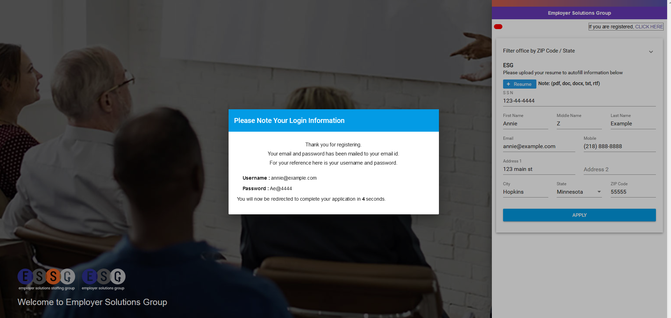
Your username and password for the portal are automatically generated as soon as you hit the “APPLY” button. If you provided an email you will get an auto generated email with your credentials. Your credentials will also appear after you hit “APPLY”

Slide 6
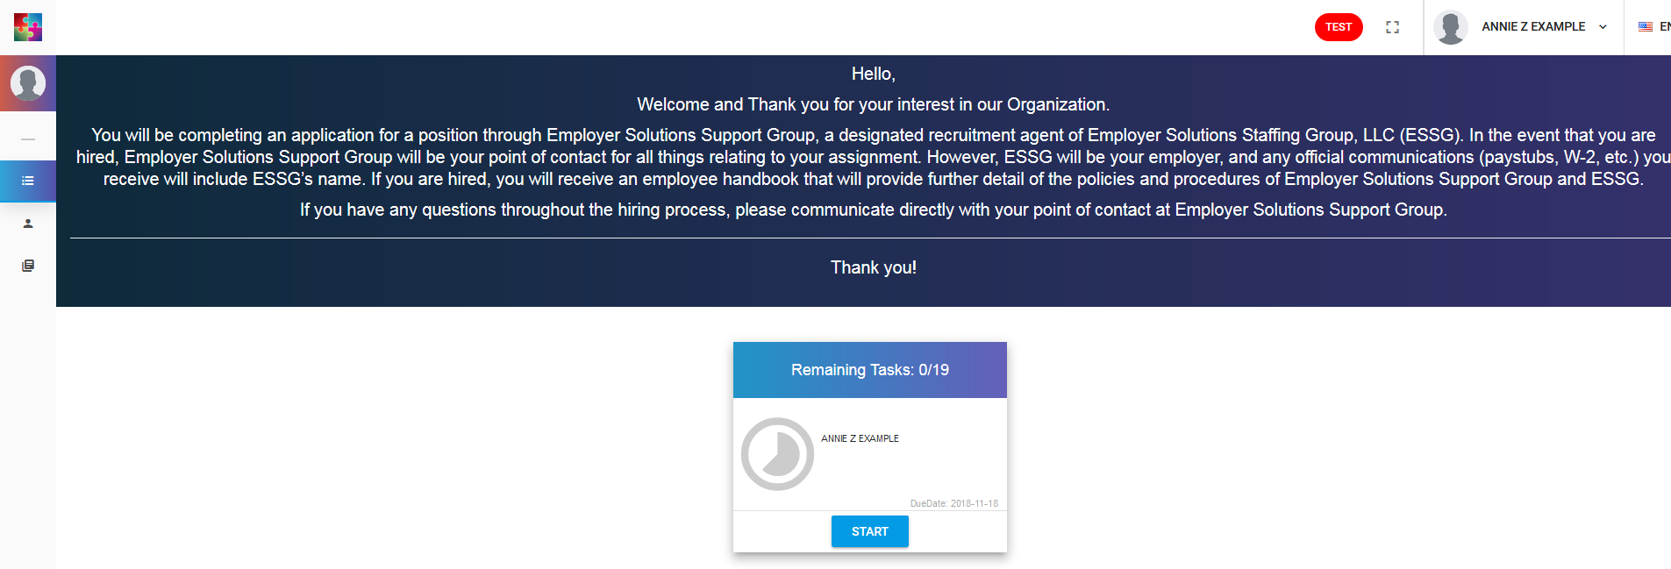
1.
This is your portal home page. You have permanent access to your portal, even after you complete all the forms. You can view the new hire forms you’ve submitted and access important read only documents like the complete handbook, FCRA, and health insurance information.
To begin completing the mandatory new hire forms click the blue “START” button

Slide 7
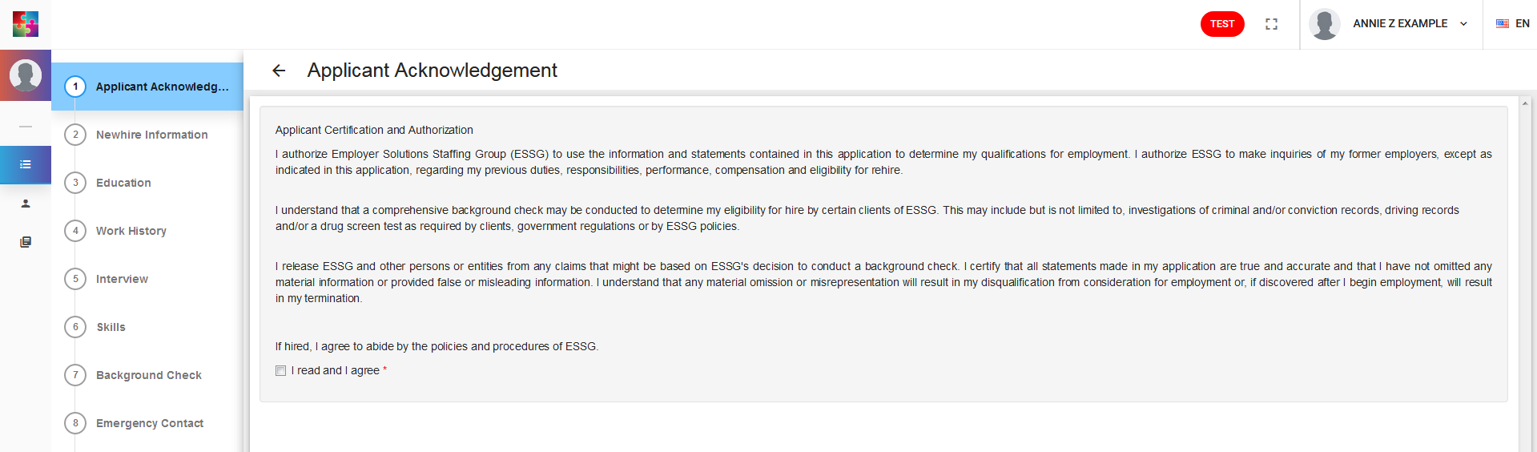
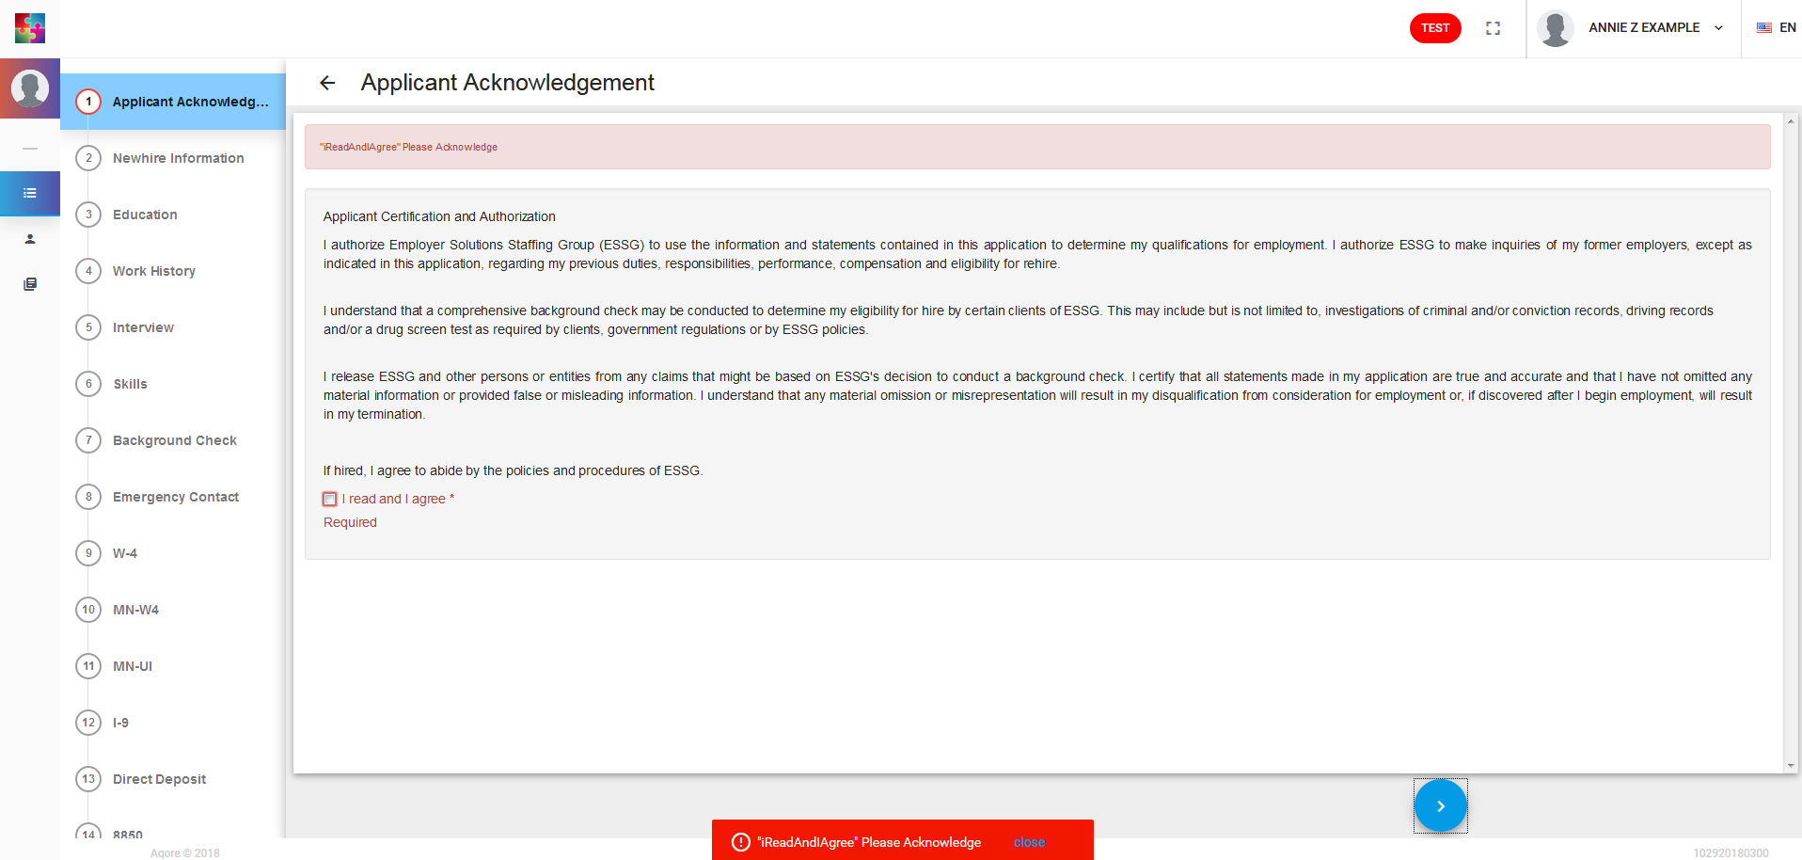
Navigation
There is a left hand menu that will show you how many forms you are in the packet and what you need to complete
All mandatory fields are marked with a red asterisk
If you skip any mandatory fields and try to move forward you will not be able to and an error message will let you know what information you need to provide
1.
2.
3.

Slide 8
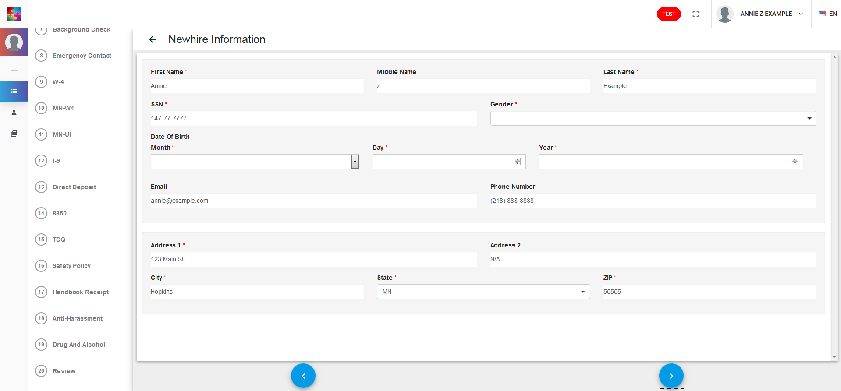
1.
2.
The new hire information form pulls in all the information you entered at the registration page. Complete the form by adding:
A gender for health insurance purposes
Date of Birth

Slide 9
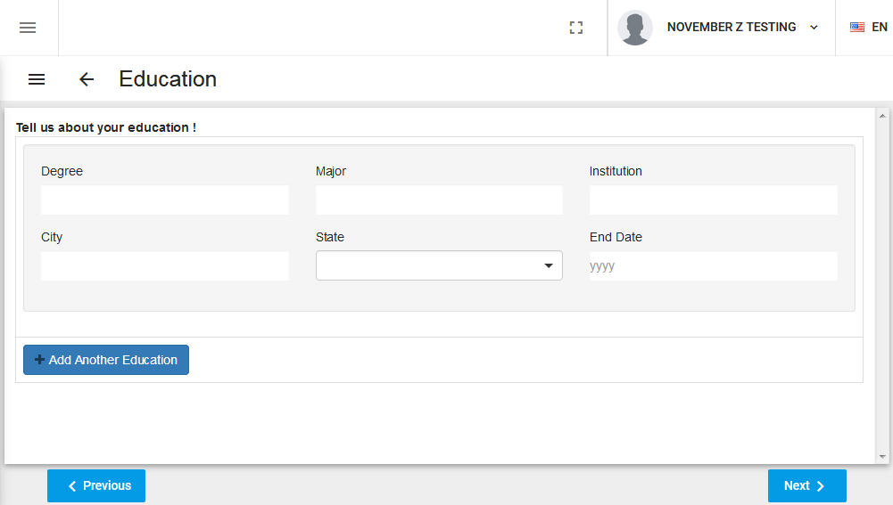
1.
1. Enter your education history. This form is voluntary.

Slide 10
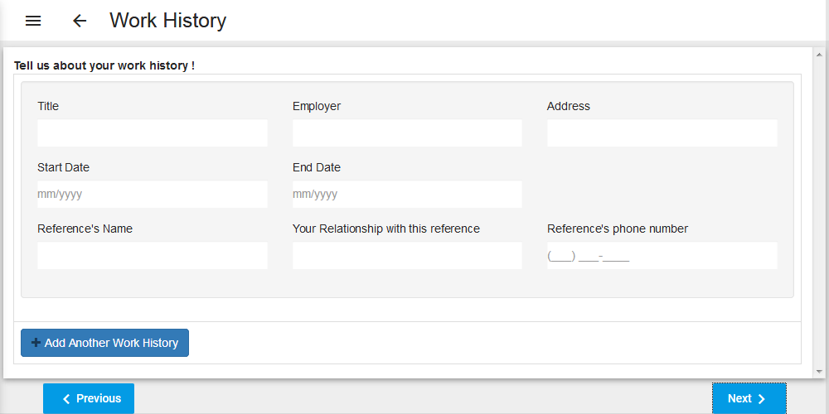
1.
1. Enter your work history an applicable references. This form is voluntary.

Slide 11
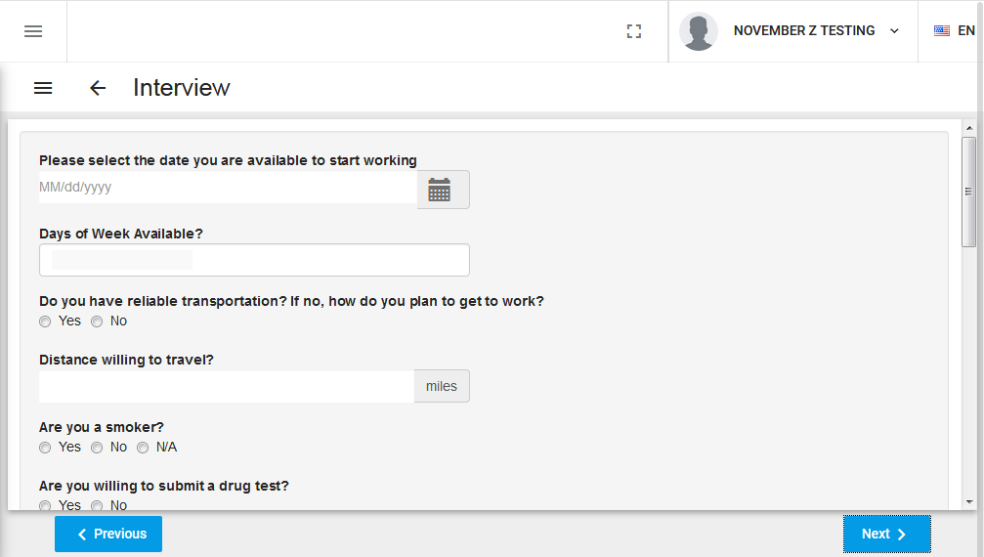
1.
Enter and/or select the appropriate answers.
This form is voluntary.

Slide 12
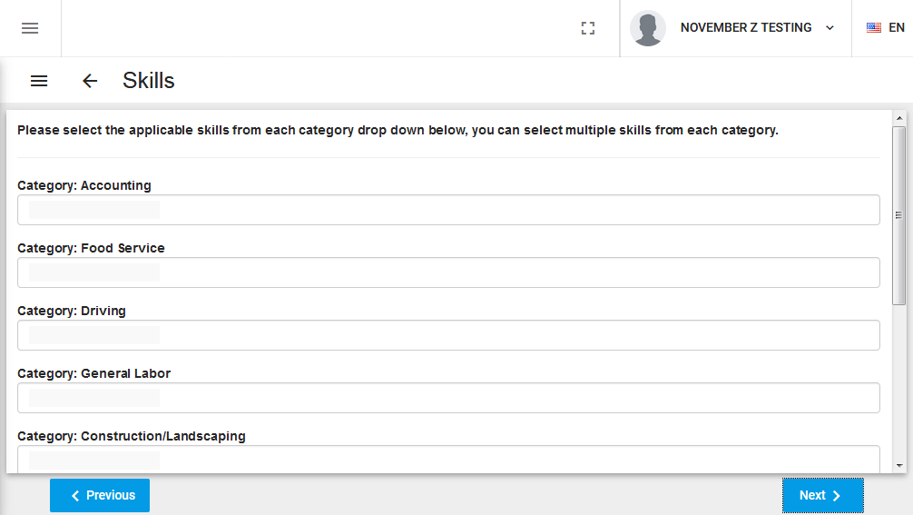
1.
1. Click on a category and select the applicable skill codes. This form is voluntary.

Slide 13
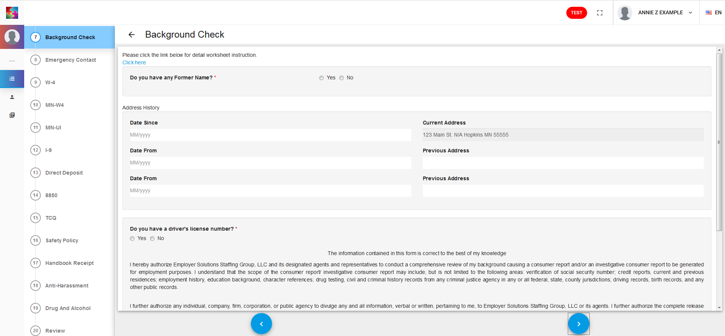
1.
2.
3.
Check whether or not you have ever held a previous legal name
Enter you address history
Check whether or not you have a DL. Even if you have a DL you can always check “no” unless you will be operating a commercial vehicle.

Slide 14
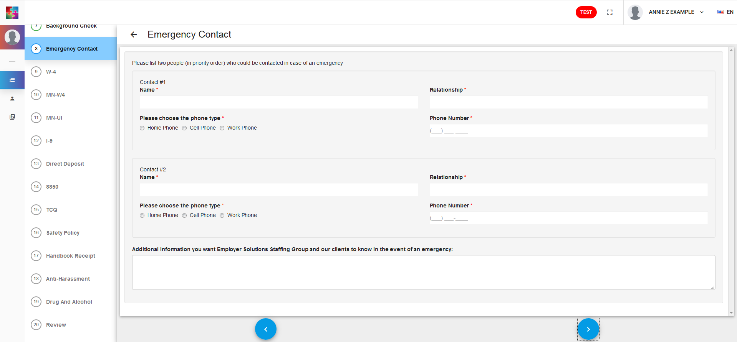
Provide 2 emergency contacts. If you do not have 2 emergency contacts please enter your 1st contact’s information twice.

Slide 15
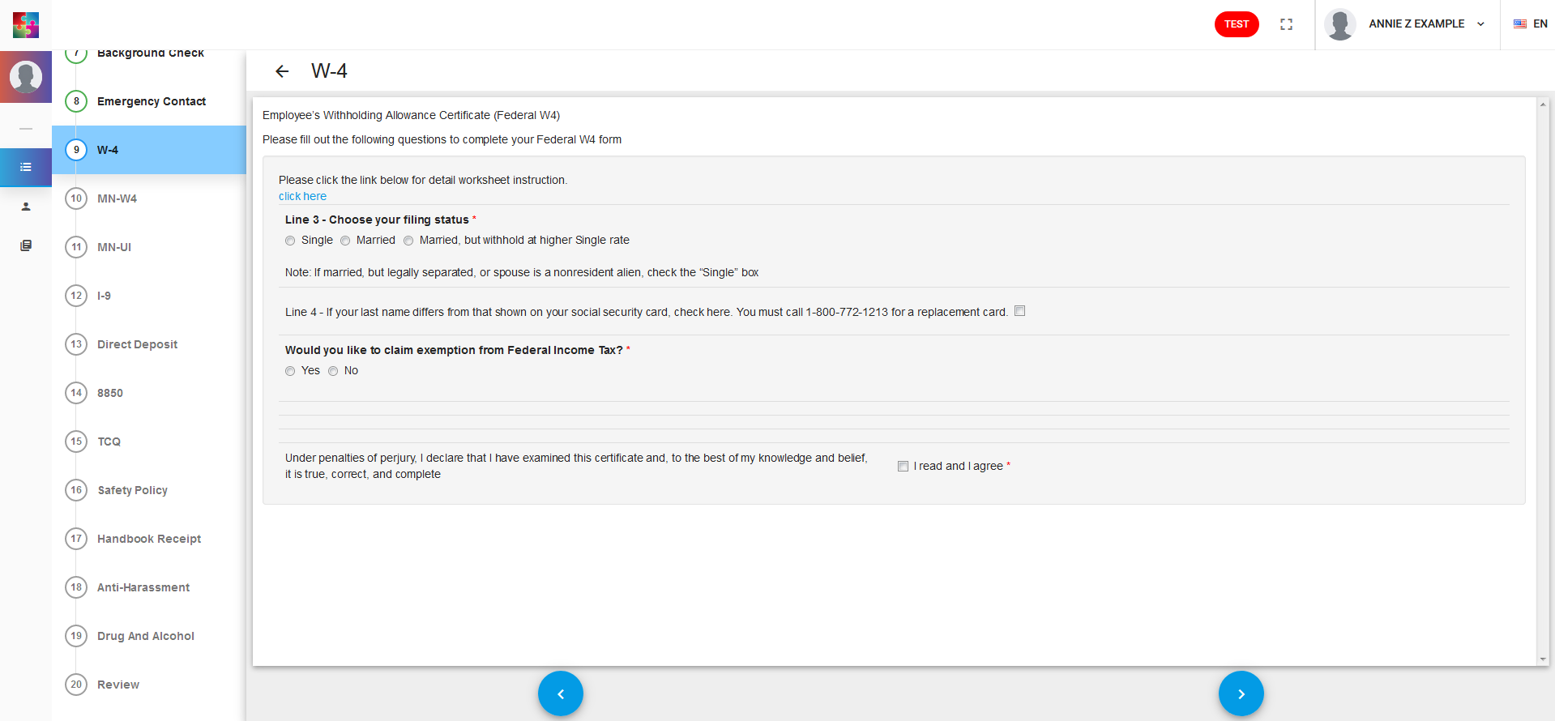
If you need the full W-4 instructions or worksheet click this link
1.
2.
Complete the federal W-4 by entering the following information:
Select your filing status
Check whether or not you are federally exempt. If you are not federally exempt you will be prompted to enter how allowances (if any) that you are claiming

Slide 16
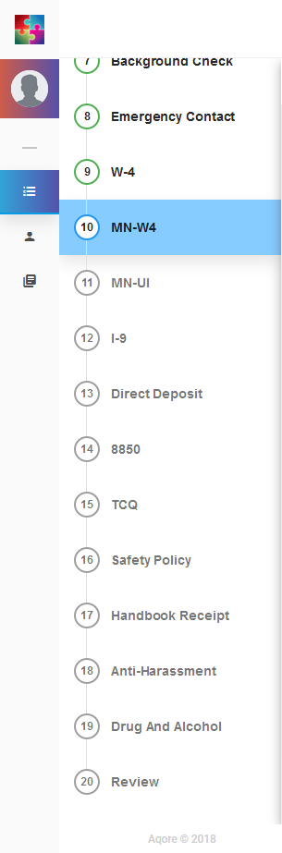
After the federal W-4 you will need to complete state specific forms, if applicable. Some states have mandatory W-2s, unemployment acknowledgements, etc. These forms will pull in based on the address you entered at the registration page.

Slide 17
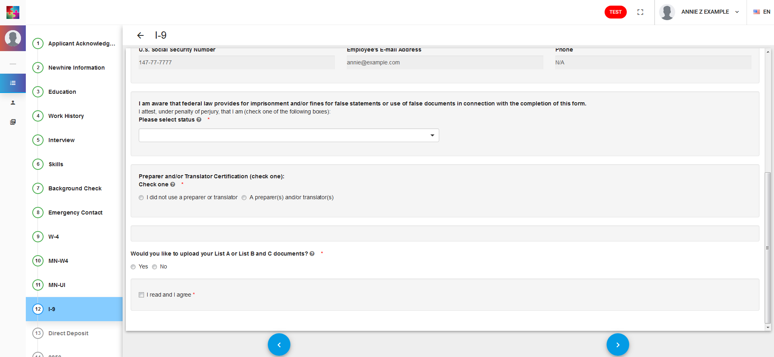
1.
2.
3.
The I-9 will pull in almost all the information for section 1 from the previous forms you’ve completed. You will need to complete the form by selecting:
Your citizenship/immigration status
Whether anyone assisted you in completing the forms
How Section 2 of your I-9 will be verified

Slide 18
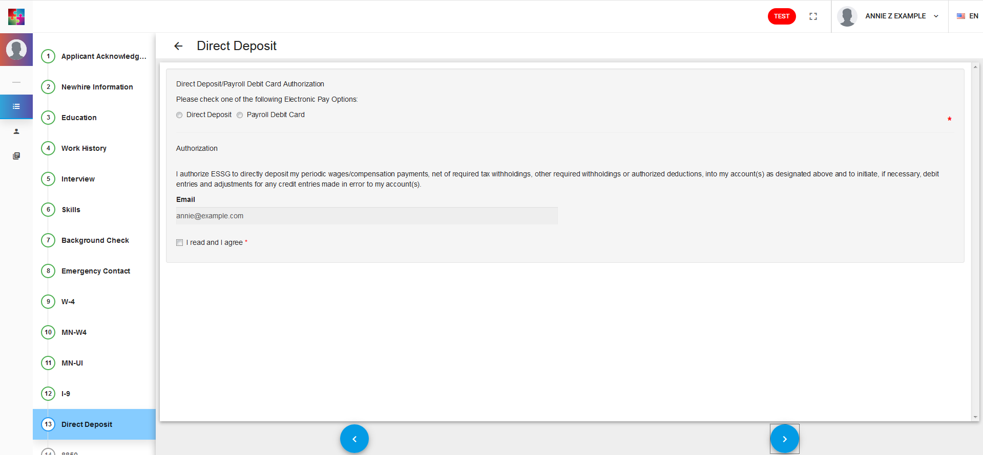
Select how you would like to be paid. If you want to be paid via direct deposit you will need to provide your bank account information.

Slide 19
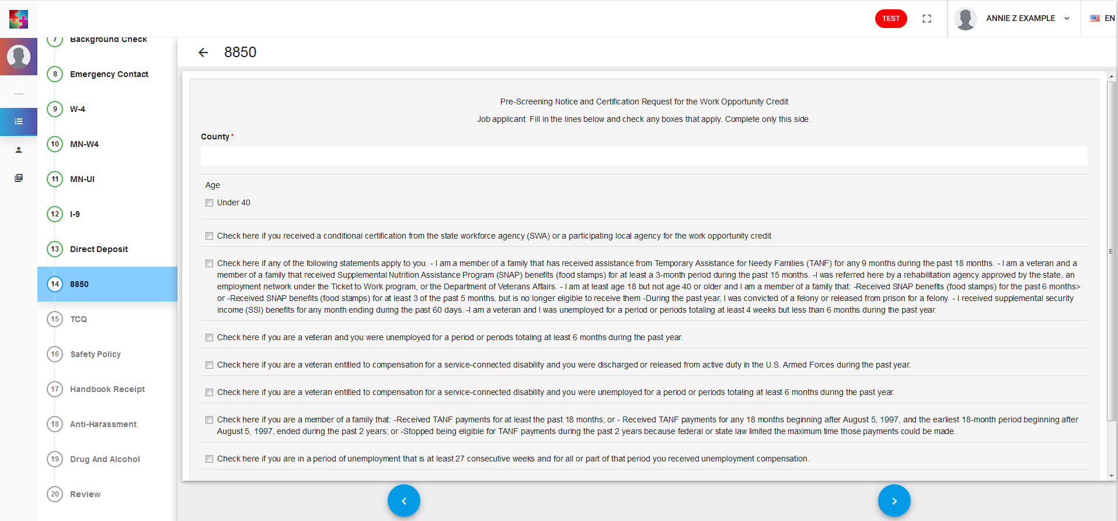
1.
2.
Enter your county of residence
After the field for your county of residence there are a series of statements that may or may not apply to you. Check all that apply.

Slide 20
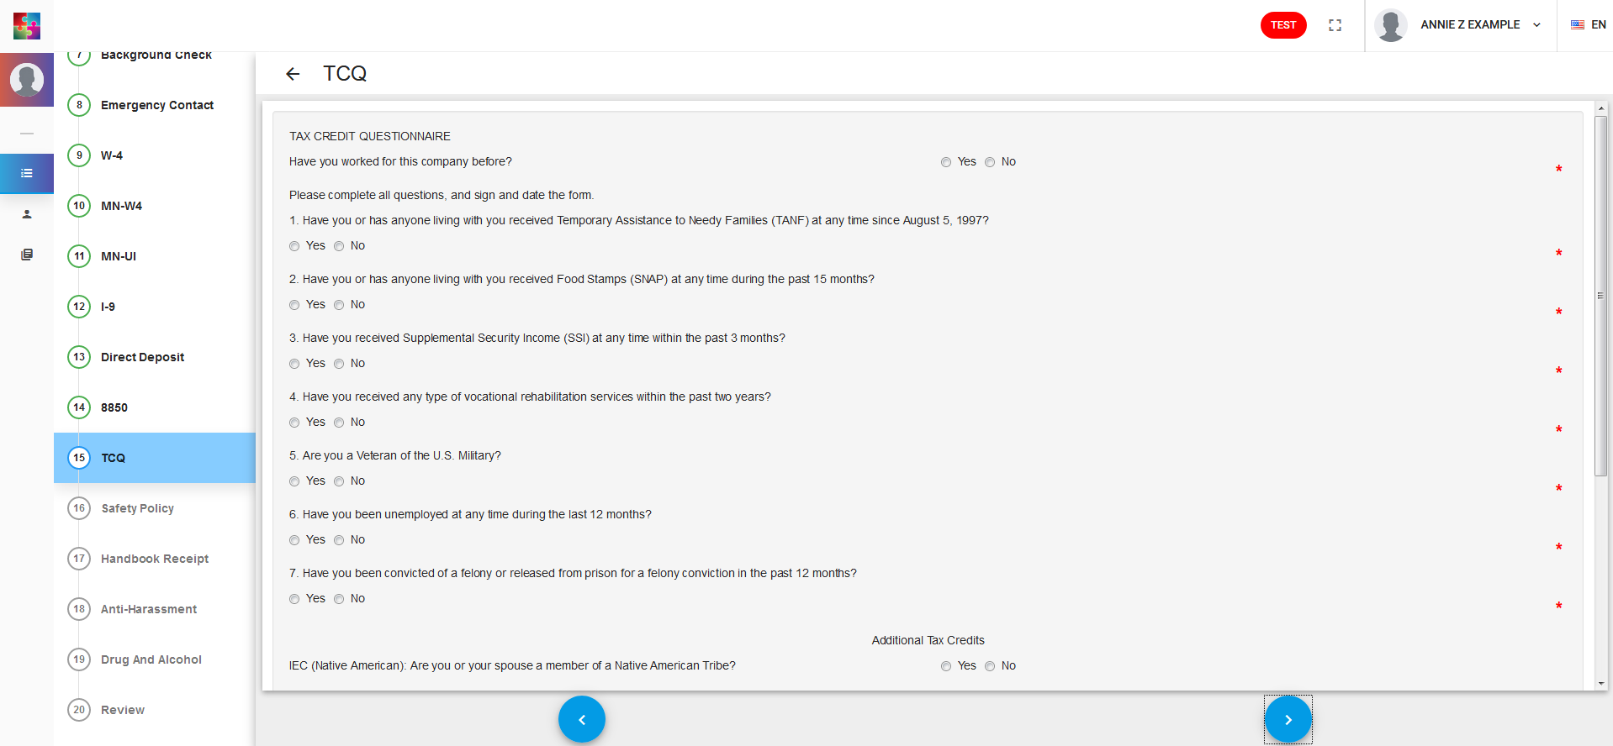
The Tax Credit Questionnaire (TCQ) is a series of mandatory “yes” or “no” questions. Please answer as applicable. If your answer to any of the questions is “yes” you will be prompted to enter additional information.
Please note that your answers to these questions cannot effect your employment eligibility.

Slide 21
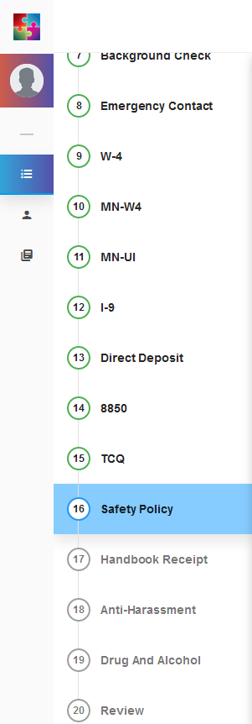
The next four forms are read and sign only. They are the sign off pages from the ESSG handbook. The full handbook is permanently available in the documents section. You can access the documents section from the far left hand menu.

Slide 22
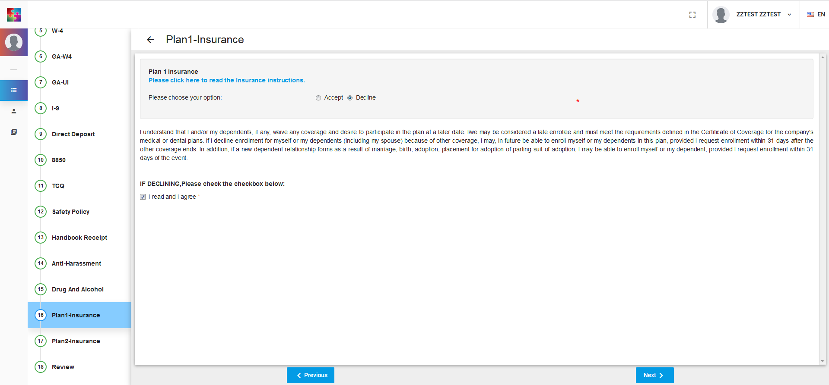
All the information relating to the two plans are available via the hyper link directly on the form as well as permanently in the read only documents section.
You have 30 days from your first day of work for pay to enroll in a new insurance plan. If you originally decline but within the first 30 days decide you would like to enroll please contact your recruiter so a new enrollment form can be added to your portal.
The final two forms are insurance enrollment options. At this point, the two insurance plans offered are 100% employee funded. If/when you are ACA eligible ESSG’s Health/Benefits team will reach out to you. You will have to enroll or decline each of the two available plans.

Slide 23
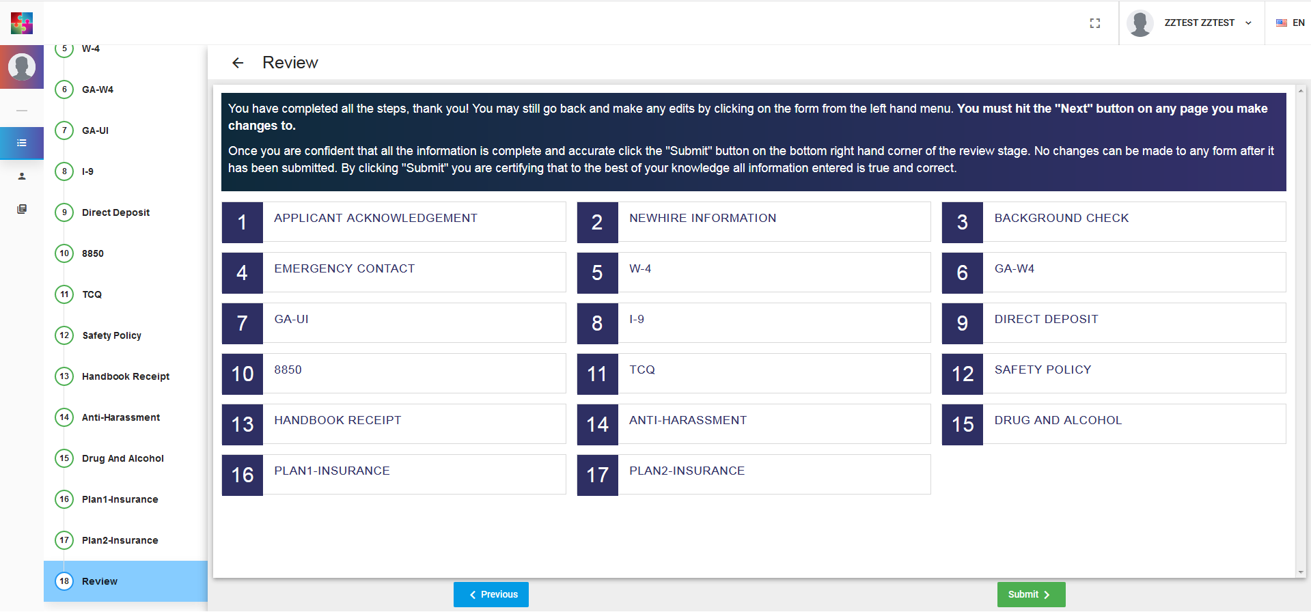
Finally, you can review all the documents and make changes as needed. To make changes select the form from the left hand menu, make the changes, and be sure to hit the “Next” button or your changes will not save. To submit the forms to your recruiter hit the green “Submit” button.

Slide 24
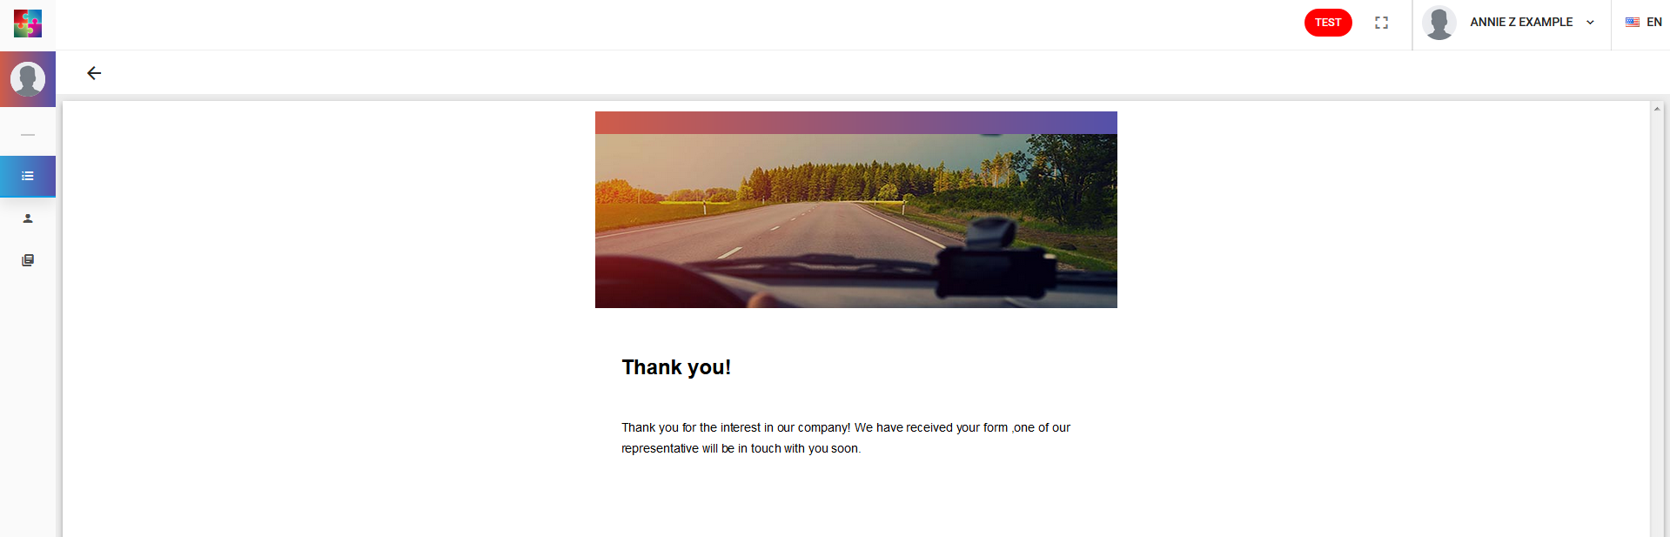
As soon as you hit the green “Submit” button you will be redirected to a thank you screen.
If you do not see the thank you screen you have only saved your documents, not submitted. Be sure to submit your documents!
The portal will automatically log you out after 15 seconds on the thank you screen. This is a measure to help maintain privacy and secure your information.

